Slide 1
2018-2019 Program of Studies
October 12, 2017

Slide 2
High School Program of Studies
Program of Studies is now completely online
Provides links to live, online resources such as NCAA and VHSL

Slide 3
Course Additions
Eleven Course Additions for 2018-2019
  CTE
  English
  Fine Arts
  Social Studies
  Science
  World Languages
Five Dual Enrollment
Two Interdisciplinary

Slide 4
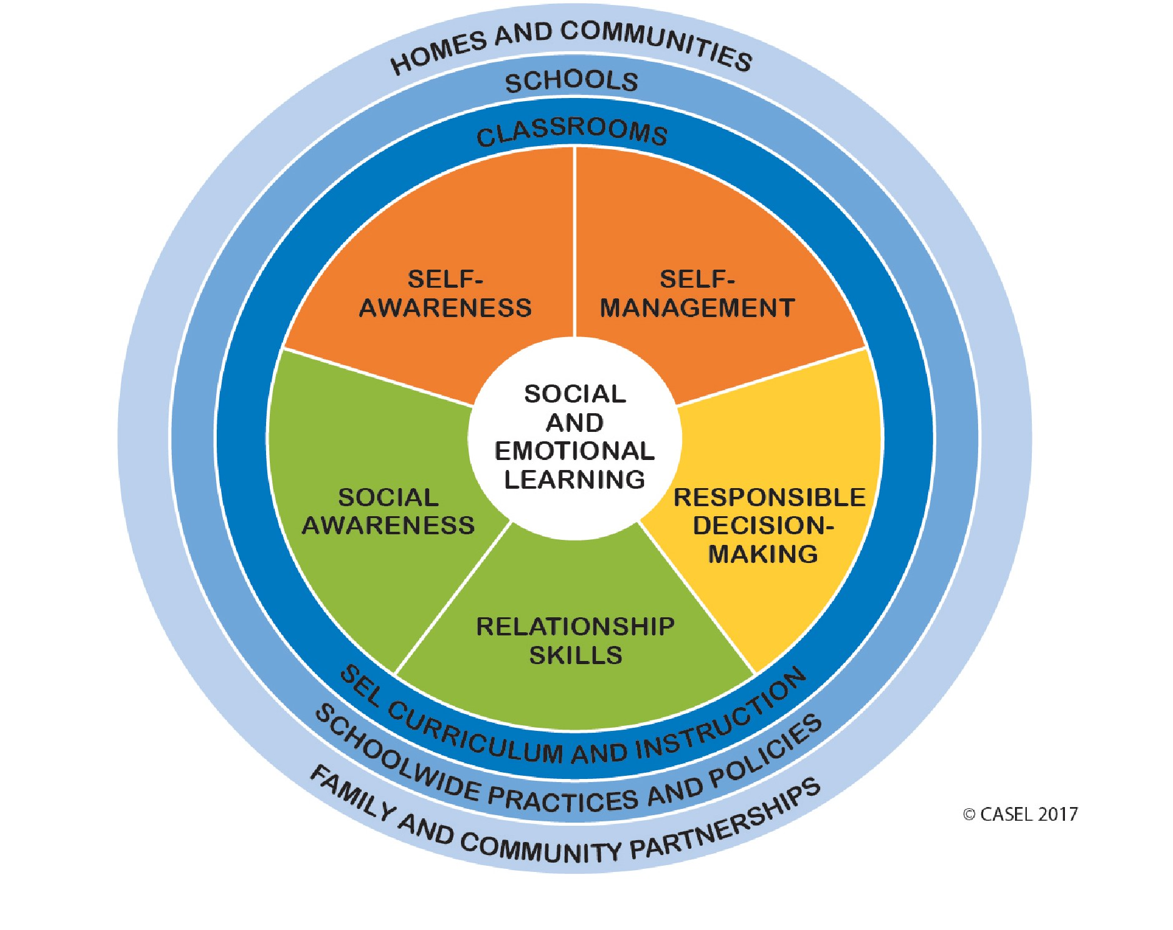
Freshman Seminar

Slide 5
Course Deletions
Schools assess program enrollment every 2-3 years and recommend deletion of courses that have not had sufficient student interest to continue
Three course deletions for 18-19

Slide 6
Middle School Electives
Outlines additions and deletions to the middle school elective program

Slide 7
Tonight
Please receive the recommend material for the program of studies

